Slide 1
1 Samuel 13:5-14
5The Philistines assembled to fight Israel, with three thousand chariots, six thousand charioteers, and soldiers as numerous as the sand on the seashore.
They went up and camped at Micmash, east of Beth Aven.
6When the men of Israel saw that their situation was critical and that their army was hard pressed, they hid in caves and thickets, among the rocks, and in pits
and cisterns.

Slide 2
1 Samuel 13:5-14
7Some Hebrews even crossed the Jordan to the land of Gad and Gilead. Saul remained at Gilgal, and all the
troops with him were quaking with fear.
8He waited seven days, the time set by Samuel; but Samuel did not come to Gilgal, and Saul's men began to scatter.
9So he said, "Bring me the burnt offering and the fellowship offerings. " And Saul offered up the burnt offering.

Slide 3
1 Samuel 13:5-14
10Just as he finished making the offering, Samuel arrived, and Saul went out to greet him.
11"What have you done?" asked Samuel. Saul replied, "When I saw that the men were scattering, and that you did not come at the set time, and that the Philistines were assembling at Micmash,
12I thought, 'Now the Philistines will come down against me at Gilgal, and I have not sought the Lord 's favor.’ So I felt compelled to offer the burnt offering."

Slide 4
1 Samuel 13:5-14
13"You acted foolishly," Samuel said. "You have not kept the command the Lord your God gave you; if you had, he would have established your kingdom over Israel for all time.
14But now your kingdom will not endure; the Lord has sought out a man after his own heart and appointed him leader of his people, because you have not kept the Lord 's command.“

Slide 5
1 Samuel 13:5-14
15Then Samuel left Gilgal and went up to Gibeah in Benjamin, and Saul counted the men who were with him. They numbered about six hundred.

Slide 6
LEARNING LESSONS OF FAITH FROM THOSE WHO HAVE GONE BEFORE

Slide 7
Samson
Moses
Joshua
Gideon
Nehemiah
LEARNING LESSONS OF FAITH FROM THOSE WHO HAVE GONE BEFORE

Slide 8
DAVID
AFTER GOD’S OWN HEART

Slide 9
WE CAN LEARN ABOUT THE LIFE OF FAITH FROM THE POSITIVE AND NEGATIVE EXAMPLES OF OT CHARACTERS
These things happened to them as examples and were written down as warnings for us, on whom the culmination of the ages has come.
1 CORINTHIANS 10:11 [NIV]

Slide 10
DAVID
IS AN EXAMPLE OF WHAT IT LOOKS LIKE TO BE A PERSON AFTER GOD’S OWN HEART
These things happened to them as examples and were written down as warnings for us, on whom the culmination of the ages has come.
1 CORINTHIANS 10:11 [NIV]

Slide 11
​​
After God’s own heart
TRUST COMPLETELY
Saul - 1 Samuel 13
situation was critical
army was hard pressed
hid in caves and thickets
crossed the Jordan
quaking with fear
began to scatter
TRUST COMPLETELY
David - 1 Samuel 17
your servant will go and fight him
The Lord who delivered me from the paw of the lion and the paw of the bear will deliver me from the hand of this Philistine
DAVID

Slide 12
​​
After God’s own heart
FOLLOW OBEDIENTLY
Saul - 1 Samuel 3:8
Go down ahead of me to Gilgal. I will surely come down to you to sacrifice burnt offerings and fellowship offerings, but you must wait seven days until I come to you and tell you what you are to do.
DAVID

Slide 13
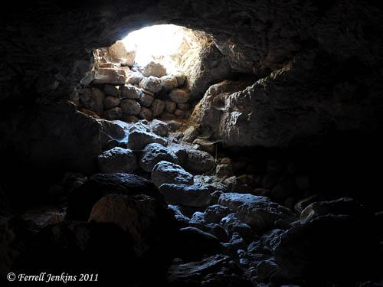
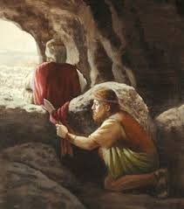
​​
After God’s own heart
DAVID

Slide 14
​​
After God’s own heart
FOLLOW OBEDIENTLY
Saul - 1 Samuel 3:8
Go down ahead of me to Gilgal. I will surely come down to you to sacrifice burnt offerings and fellowship offerings, but you must wait seven days until I come to you and tell you what you are to do.
FOLLOW OBEDIENTLY
David - 1 Samuel 24:10
This day you have seen with your own eyes how the Lord delivered you into my hands in the cave. Some urged me to kill you, but I spared you; I said ‘I will not lift my hand against my master, because he is the Lord’s anointed.’
DAVID

Slide 15
​​
After God’s own heart
REPENT WHOLEHEARTEDLY
Saul - 1 Samuel 13:11-12
When I saw that the men were scattering and that you did not come at the set time, and that the Philistines were assembling at Micmash, I thought, ‘Now the Philistines will come down against me at Gilgal, and I have not sought the Lord’s favour.’ So I felt compelled to offer the burnt offering.
DAVID

Slide 16
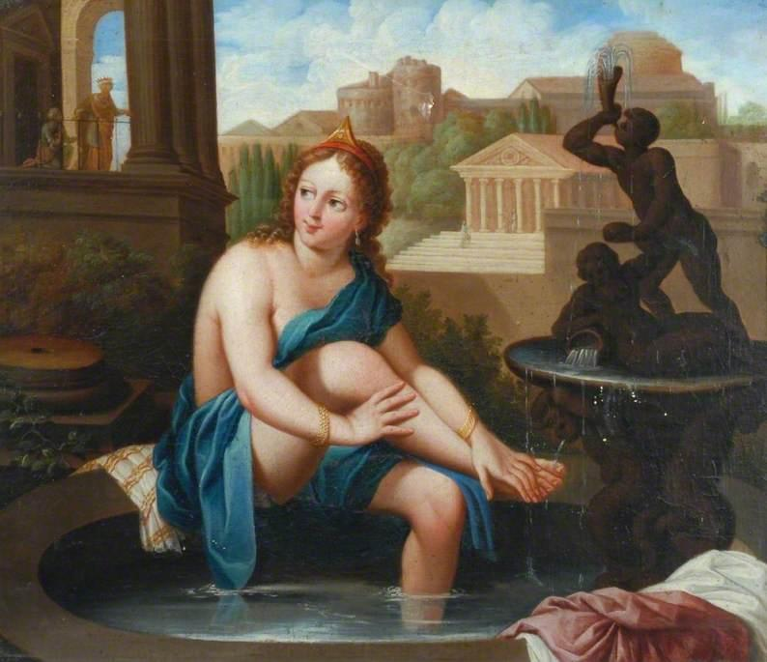
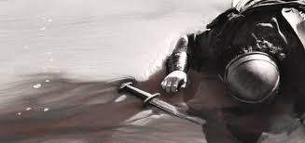
​​
After God’s own heart
DAVID

Slide 17
​​
After God’s own heart
REPENT WHOLEHEARTEDLY
Saul - 1 Samuel 13:11-12
When I saw that the men were scattering and that you did not come at the set time, and that the Philistines were assembling at Micmash, I thought, ‘Now the Philistines will come down against me at Gilgal, and I have not sought the Lord’s favour.’ So I felt compelled to offer the burnt offering.
REPENT WHOLEHEARTEDLY
David - 2 Samuel 12:13
I have sinned against the Lord
DAVID

Slide 18
After God’s own heart
DAVID’S EXAMPLE SHOWS THAT IF WE SEEK TO BE A PERSON AFTER GOD’S HEART WE NEED TO...
Trust completely
Follow obediently
Repent wholeheartedly
DAVID

Slide 19
LEARNING LESSONS OF FAITH FROM THOSE WHO HAVE GONE BEFORE

